Slide 1
VLSI DESIGN
Lecture 7
B.E (ECE) 5th semester

Slide 2
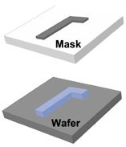
Masking and Lithography
Lithography is a process of drawing patterns on a
silicon wafer.
The patterns are drawn with a light sensitive polymer called photoresist.
The lithography and etch-pattern transferring steps are repeated 20-30 times to build a complex structure required for an IC.

Slide 3
Optical Lithography
Optical lithography is a photon-based technique comprised of projecting an image into a photosensitive emulsion (photoresist) coated onto a substrate such as a silicon wafer. It is the most widely used lithography process in the high volume manufacturing of nano-electronics by the semiconductor industry.
A photographic process by which the light-sensitive polymer (photoresist) is exposed and developed to form three- dimensional image on the substrate is called optical lithography.
The photoresist image should have the exact shape of the intended pattern in the plane of the substrate.

Slide 4
Lithography is the heart of the semiconductor fabrication process. It is used to pattern specific shapes of a thin layer on a rigid substrate for fabricating electrical devices. ... The photoresist lateral shape will be transferred into the underneath layer by a subsequent treatment such as etching.

Slide 5
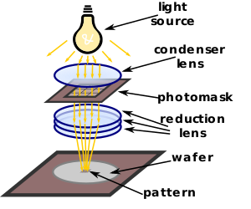
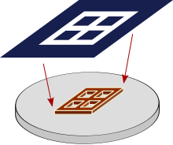
Photomask
A photomask is an opaque plate with holes or transparencies that allow light to shine through in a defined pattern.

Slide 6
Photoresist
A photoresist (also known simply as a resist) is a light-sensitive material used in photolithography, to form a patterned coating on a surface.
They are light-sensitive materials, composed of a polymer. The polymer changes its structure when it is exposed to radiation.
Spin coating is the most common method for applying photoresist to a substrate surface. ... In a typical spin coating process, the photoresist is applied to the center of rotating wafer and the spin speed is then increased rapidly to spread the resist evenly from the center to the edges.

Slide 7
There are four basic components of photoresist: polymer, solvent, photosensitive agent and additive.
Polymer: When polymer is exposed to lithography machine, its structure changes from soluble to polymeric. The polymer is a special photosensitive polymer, generally composed of a group of large and heavy molecules, including carbon, hydrogen and oxygen. Plastics are typical polymers.
Solvent: It is the largest component of photoresist, used to dilute the photoresist and keep the photoresist in liquid. Then, photoresist coats on the wafer surface to form a thin layer by rotation. The solvent used for negative photoresist is a fragrant xylene, while that used for positive photoresist is ethyl ethoxyacetate or dimethoxyacetaldehyde.

Slide 8
Photosensitive agent: Control and adjust the chemical reaction of photoresist during exposure.
Photosensitizer: It is added to the photoresist to limit the spectral range of reactive light or to limit the reactive light to a specific wavelength.
Additives: Different types of additives and photoresist are mixed together to achieve specific results, such as adding dyes in negative photoresist to absorb and control light, and adding anti-dissolving agent in positive photoresist.

Slide 9
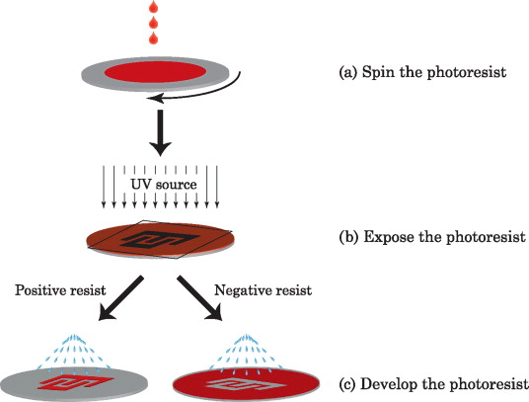
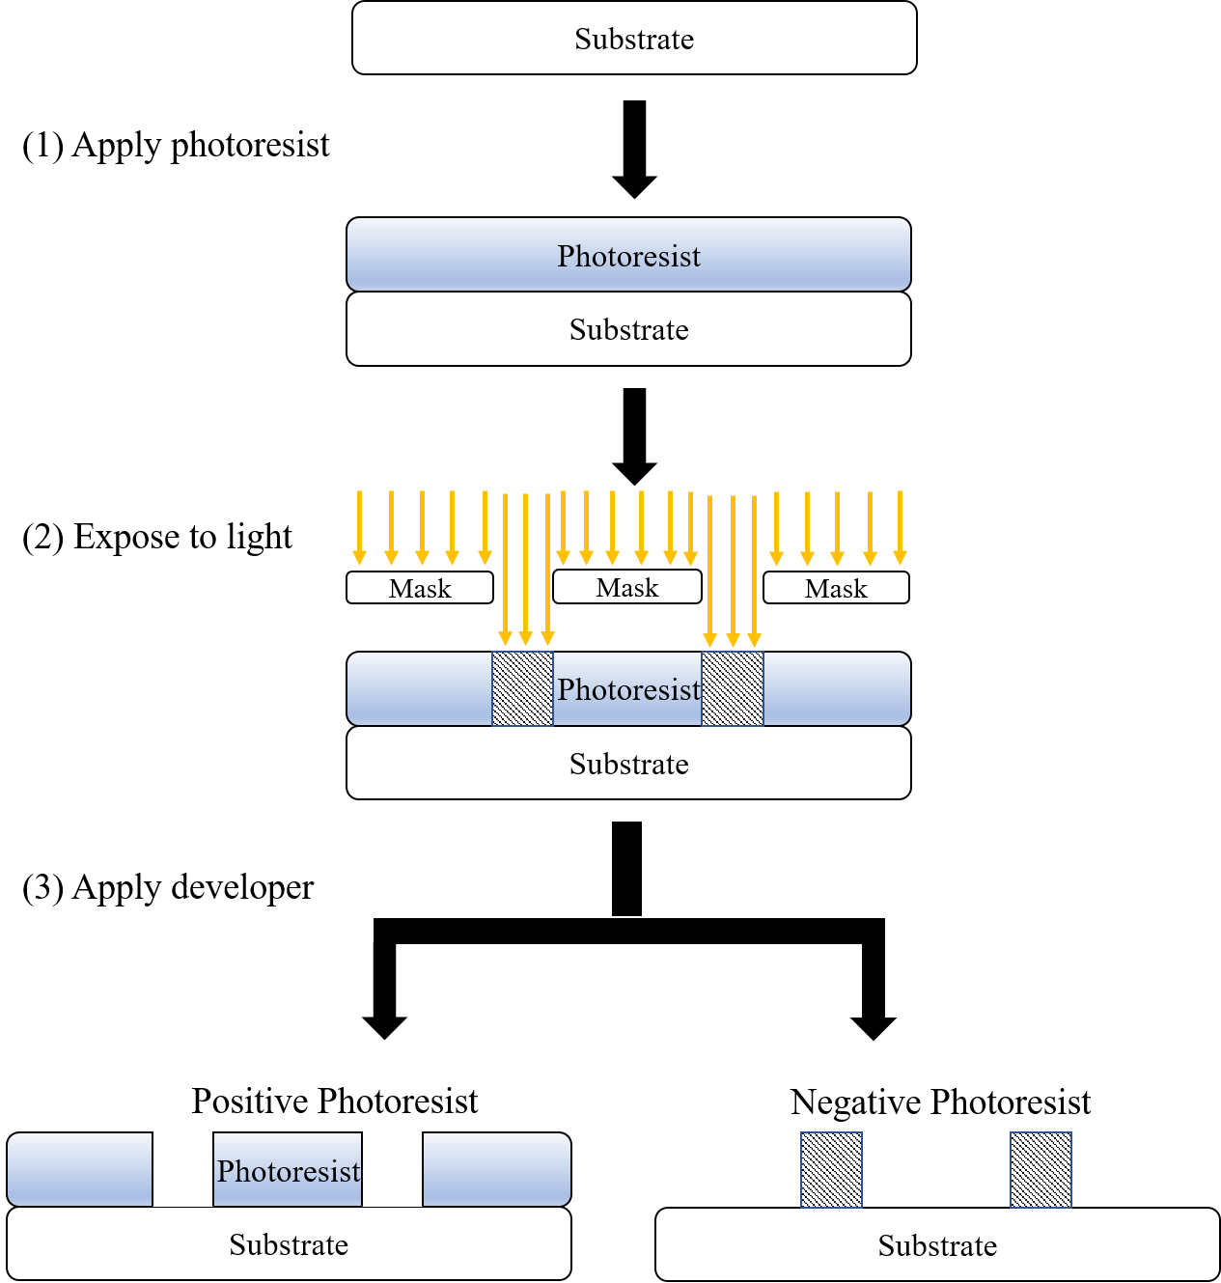
Negative Photoresist: Exposure to light decreases the solubility of the polymer (Opening in mask = closed in resist)
Positive Photoresist: Exposure to light increases the solubility of the polymer (Opening in mask = Opening in resist)

Slide 10
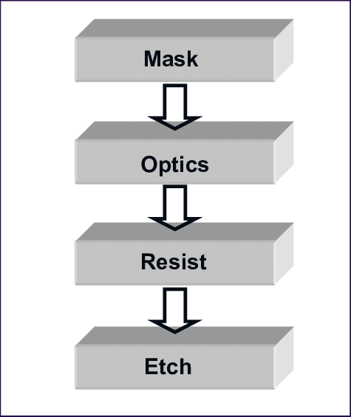
Procedure for Pattern Transfer

Slide 11
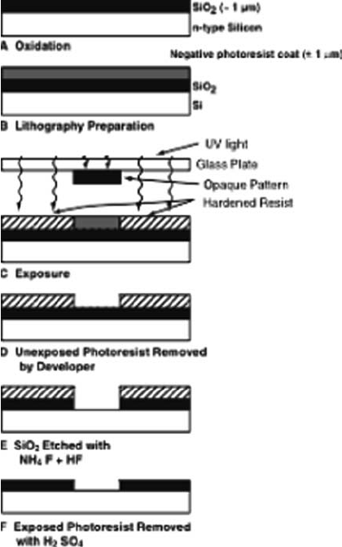
Preparation of wafer.
Photoresist application.
Exposing.
Developing.
Baking
Etching
Photoresist removal

Slide 12
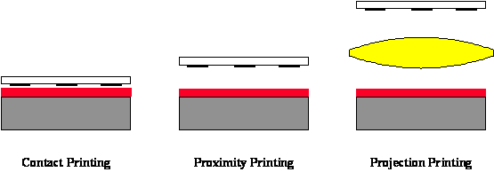
Methods to expose photoresist
Contact and proximity lithography are the simplest methods of exposing a photoresist through a master pattern called a photomask.
Contact lithography offers high resolution (down to about the wavelength of the radiation), but practical problems such as mask damage and resulting low yield make this process unusable in most production environments.
Proximity printing reduces mask damage by keeping the mask a set distance above the wafer (e.g., 20 μm). Unfortunately, the resolution limit is increased to greater than 2 to 4 μm, making proximity printing insufficient for today’s technology.

Slide 13
Projection lithography derives its name from the fact that an image of the mask is projected onto the wafer.
Projection lithography became a viable alternative to contact/proximity printing with the advent of improved optical materials which allowed the production of lens elements of sufficient quality to meet the requirements of the semiconductor industry. Such an optical system is said to be diffraction-limited, since it is diffraction effects and not lens aberrations which, for the most part, determine the shape of the image.

Slide 14
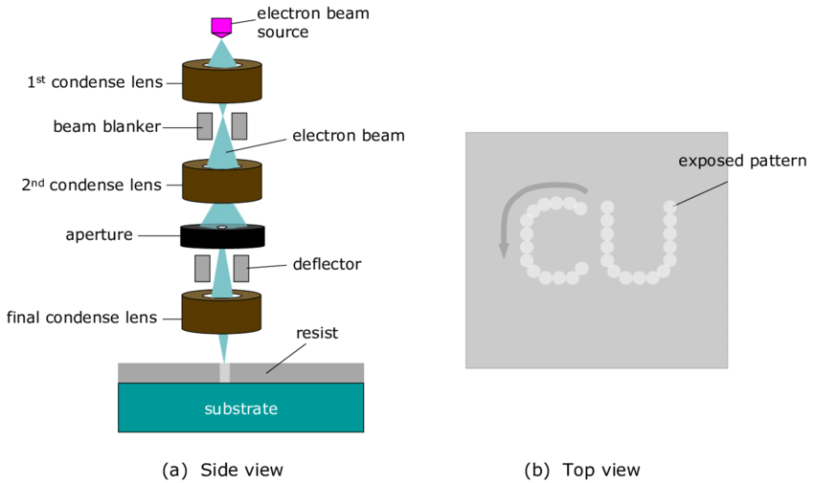
Electron beam lithography

